Slide 1
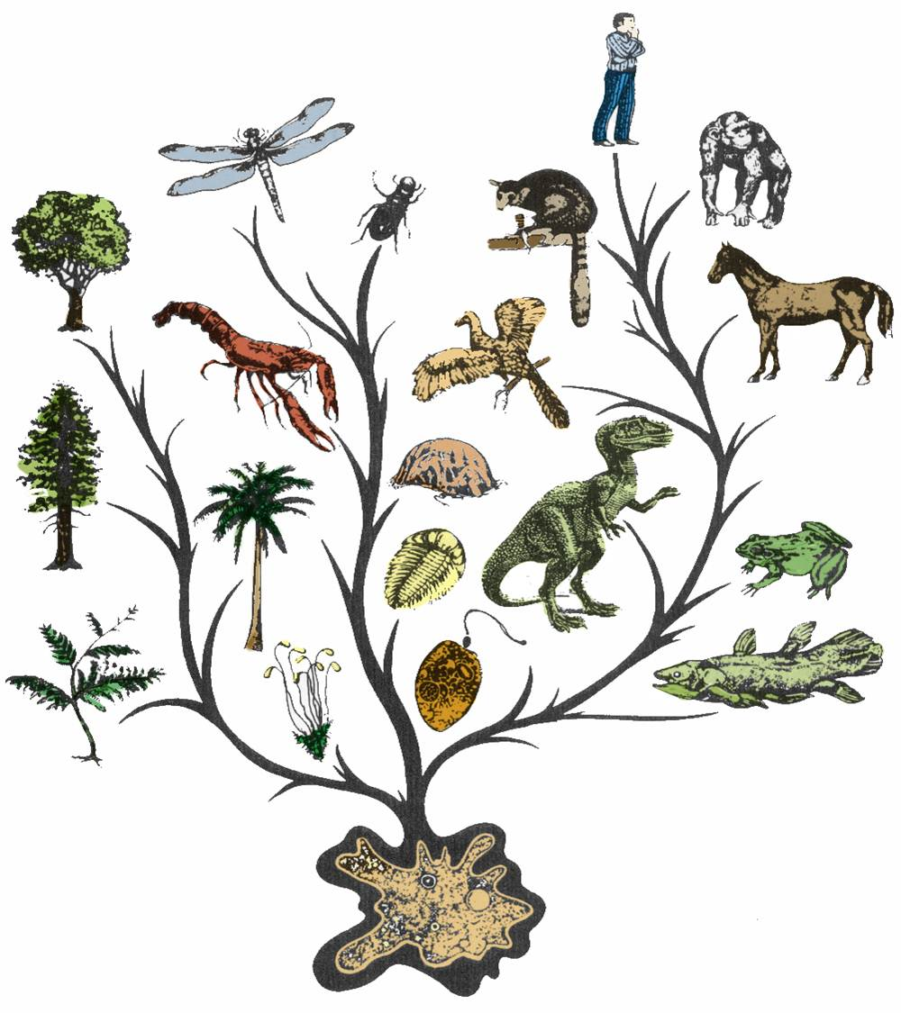
Evolution
It’s a Family Affair

Slide 2
Today’s Lesson
Diversity and Evolution
of Living Organisms
I. The scientific theory of evolution is the organizing principle of life science.
II. The scientific theory of evolution is supported by multiple forms of evidence.
III. Natural Selection is a primary mechanism leading to change over time in organisms.

Slide 3
What is Evolution
It means that all living things on Earth are descended from a common ancestor.
The great diversity of organisms is the result of more than 3.5 billion years of evolution that has filled every available niche with life forms.
The millions of different species of plants, animals, and microorganisms that live on earth today are related by descent from common ancestors.

Slide 4
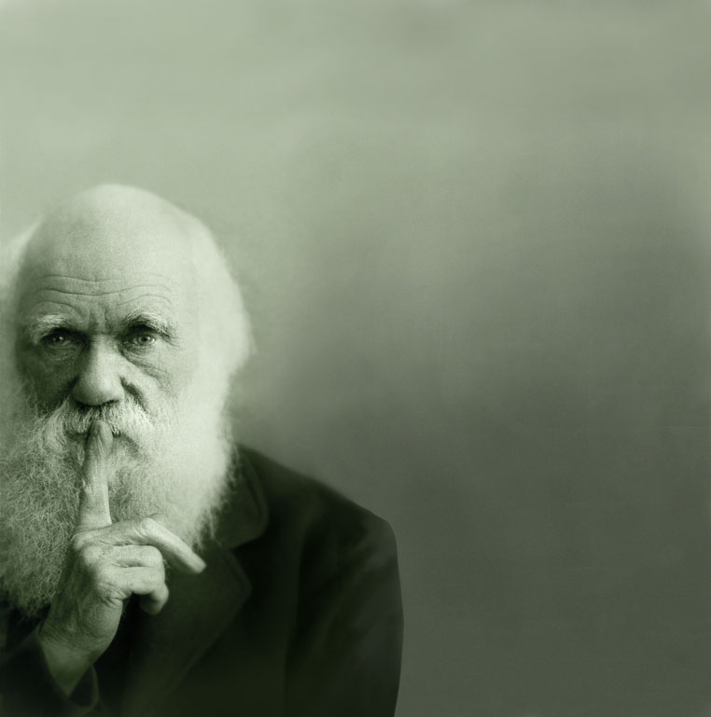
The concepts of common descent and natural selection were first proposed by Charles Darwin in his famous book, The Origin of Species in 1859
Notes:
This could read like evolution was first proposed by Darwin, as opposed to common descent/natural selection

Slide 5
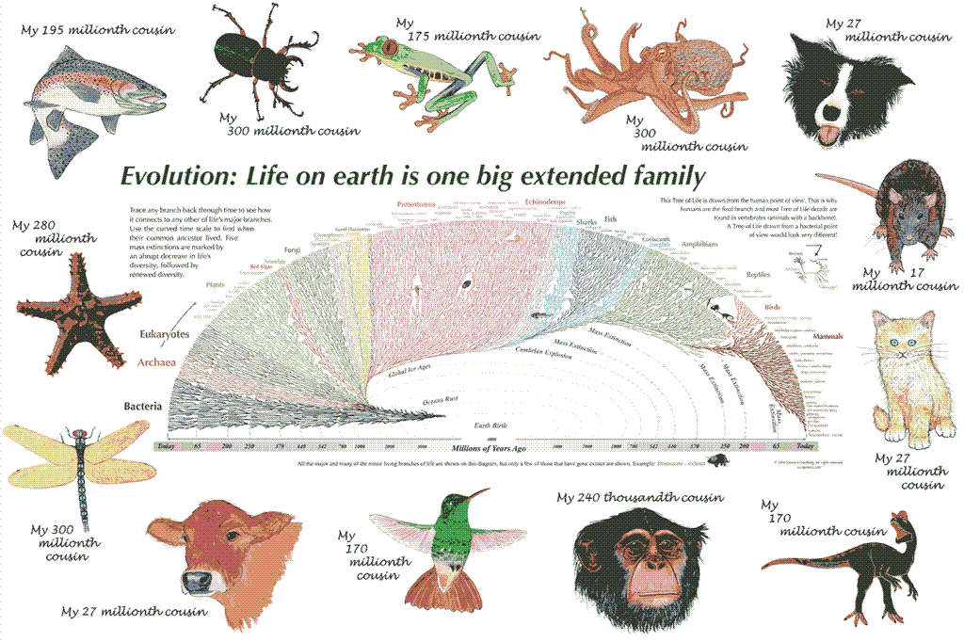

Slide 7
Evidence for Evolution comes from different sources and various disciplines:
Fossils
Biogeography
The Law of Superposition
Artificial Selection
Vestigial Organs: The evolutionary legacy we carry within our own bodies
Similarities: Comparative Anatomy
Overwhelming Genetic Evidence (not available in Darwin’s time)
Notes:
Homologous traits actually cover your #s 1, 5, & 7! They are all homologies…

Slide 8
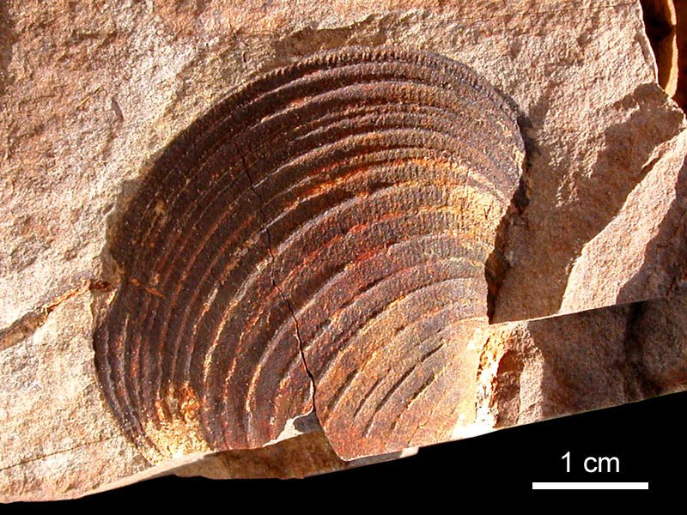
1. Fossils: Traces of long-dead organisms There are different types of fossils here are just a few.
A fossil mold is formed by the impression left in rock by the remains of an organism.
Notes:
This isn’t a mold. It’s a body fossil, I think?
You’re missing some types of fossils – if you think it’s important to talk about all the different kinds, then you should have them all. See: http://ncse.com/blog/2014/11/misconception-monday-fossils-everywhere-part-2-0016012

Slide 9
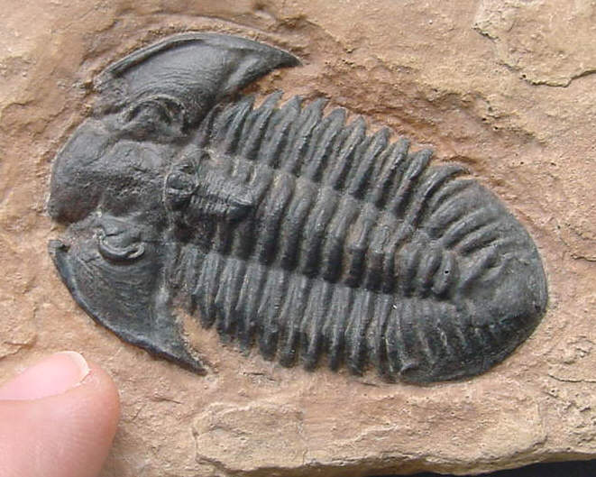
Types of Fossils
A cast fossil occurs when the mold is filled in by precipitating minerals.

Slide 10
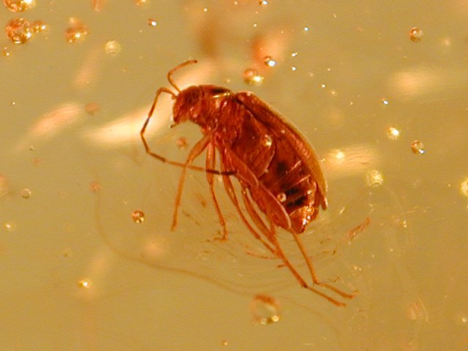
Types of Fossils
Amber: fossilized tree resin that can contain organisms

Slide 11
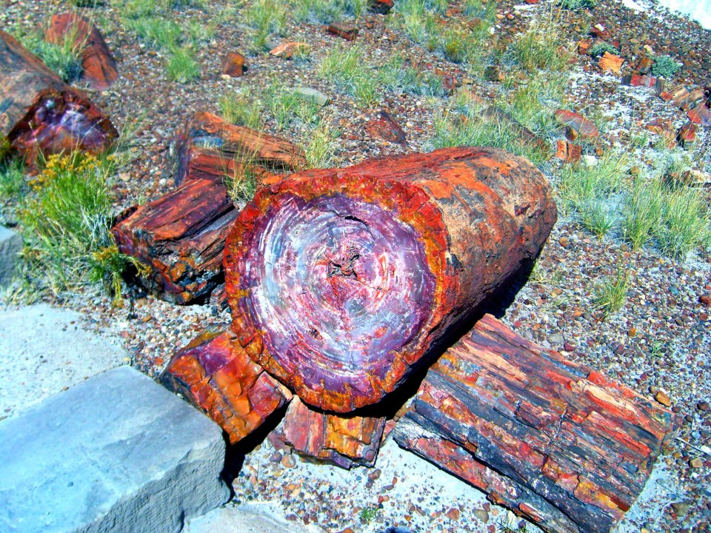
Types of Fossils
Petrified wood forms when plant material is buried by sediment and protected from decay by oxygen and organisms. Then, groundwater rich in dissolved solids flows through the sediment replacing the original plant material with organic material.

Slide 12
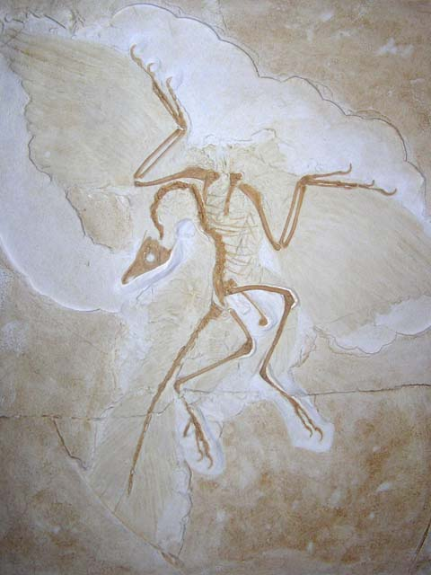
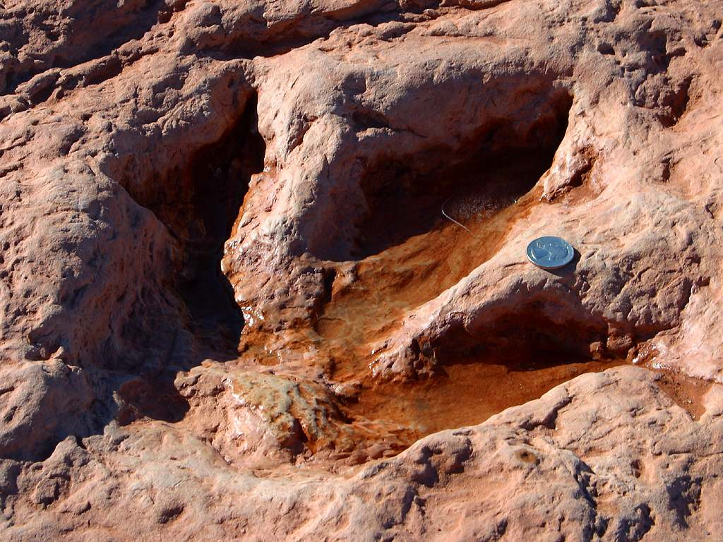
To learn more about the many different types of fossils, check out: The National Center for Science Education's Article on the subject

Slide 13
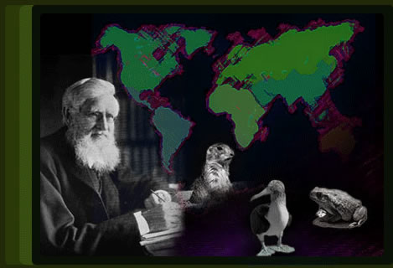
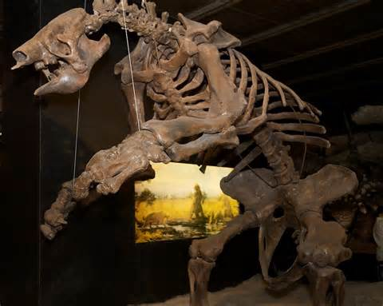
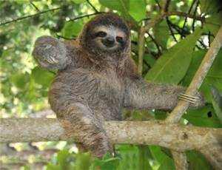
2. Biogeography: the study of the geographical distribution of fossils.
For example, in the Origin of Species, Darwin pointed out that fossils of giant armadillos and ground sloths are found only in the Americas, not in the Old World or Australia.
He thought that it was probably not a coincidence that modern-day armadillos and tree sloths are only found naturally in the Americas as well.
Notes:
Not sure about that second bullet…. That happens sometimes, but not always! In fact, sometimes, similar forms “force” divergence. I think you should rejigger this slide a bit and give some concrete examples. How does biogeography inform evolution? There are a number of approaches, one would be to talk about convergent evolution and another would be to talk about adaptive radiation, and still another would be to pull in plate tectonics…

Slide 14
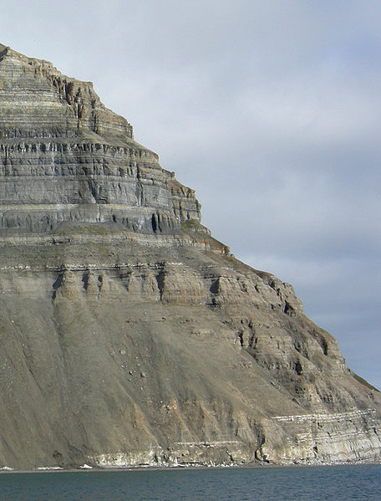
3. The Law of Superposition
Successive layers of rock or soil were deposited on top of one another by wind or water
The lowest layer (stratum) will be the oldest.
Relative age: a given fossil is younger or older than what is below or above it
Absolute age: actual age based on amount of sediment around fossil
The fossil record shows five mass extinctions in Earth history
Notes:
Third bullet: backwards. A given fossil is younger or older than what is below it or above it (respectively)
How is superposition evidence for evolution? Make the connection clear.

Slide 15
3. The Law of Superposition
The oldest rock (lowest)
contains the oldest organisms.
Notes:
Eeeeh… no, don’t use “primitive” unless you define it specifically to mean, “evolved first” – it can be taken to mean “simple” and that’s not good. Better to just say that lower rock layers contain older organisms

Slide 16
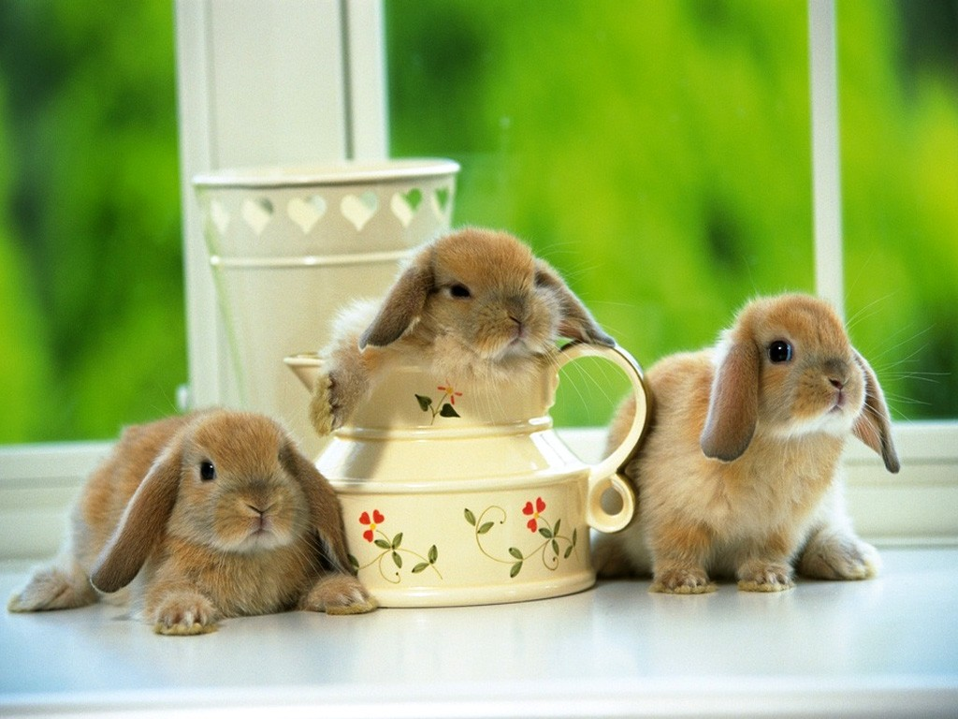
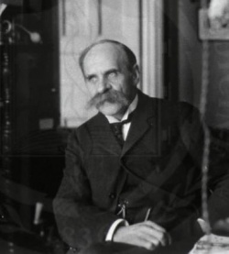
What would make you change your mind about Evolution?
The famous biologist, J.B.S. Haldane, answered, “Find me a rabbit fossil in Pre-Cambrian Rock.”

Slide 17
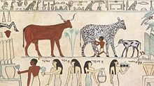
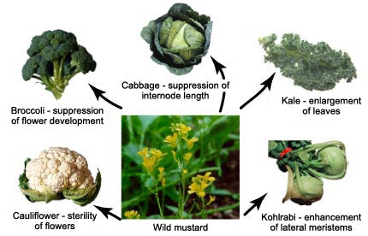
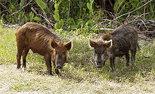
4. Artificial Selection
Darwin noticed how farmers and breeders allowed only the plants and animals with desirable characteristics to reproduce, causing the evolution of farm stock. He used this as evidence in Origin of Species.
Cows being milked in
ancient Egypt
These pics both show the same animal,
feral vs. domestic pigs.

Slide 18
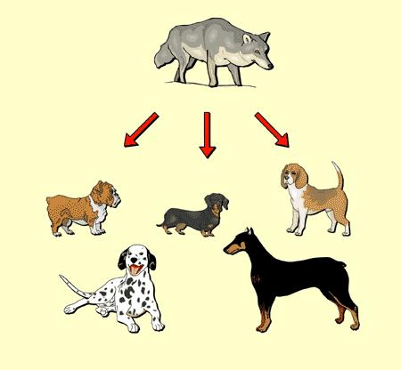
A Great Example of Artificial Selection
“Artificial selection provides a model that helps us understand natural selection.
It is a small step to envision natural conditions acting selectively on populations
and causing natural changes.”
From www.evolution.berkeley.edu
Notes:
What is the connection to evolution?

Slide 19
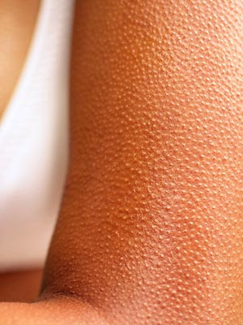
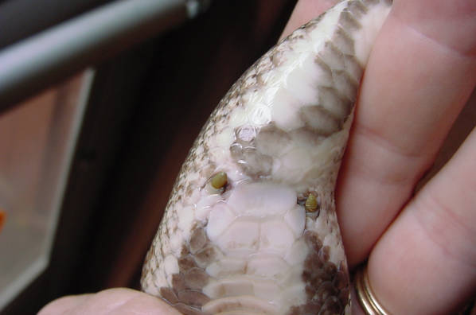
5. VESTIGIAL STRUCTURES are features that were adaptations for an organism’s ancestor but have evolved to no longer perform their original function due to a change in the organism’s environment.
Anal spurs on a ball python
Goose bumps
Goose bumps
C= hind legs on whale skeleton
Notes:
19
Be careful here! Vestigial structures aren’t really non-functional—rather, they do not perform their original adaptive function.
http://ncse.com/blog/2014/07/misconception-monday-everything-is-adaptation-part-1-0015749

Slide 20
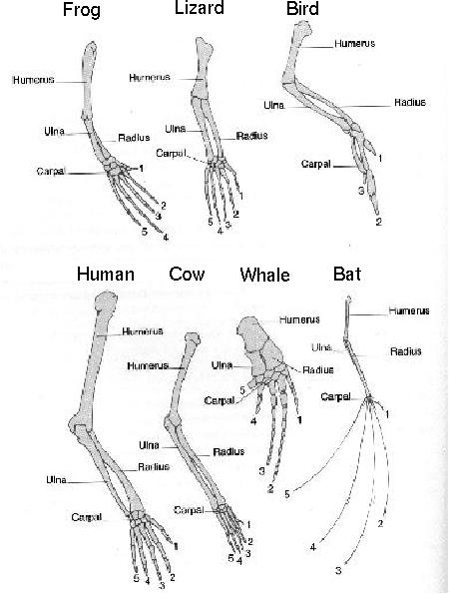
6. Similarities among related organisms:
Homologous structures:
Comparative Anatomy: The study of Homologous traits (ex. forearms) features in different species that are similar because those species share a common ancestor.

Slide 21
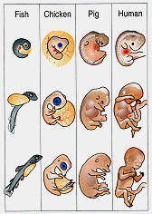
Embryonic development is also strikingly similar among related organisms.
Comparative Embryology:
Notes:
Suggest not showing a human for sensitivity issues

Slide 22
7. The latest overwhelming evidence for evolution comes from molecular biology
Molecular Biology: is the strongest evidence for evolution. Not even known in Darwin’s time, it involves comparing the DNA of different species to determine their relatedness.
Just like our forelimbs or embryos are similar, so are our genes.
Genes are also homologous structures.

Slide 23
So What is a Gene?

Slide 24
And what is DNA?
The function of DNA is to store and transmit the genetic information that tells cells which proteins to make and when to make them

Slide 25
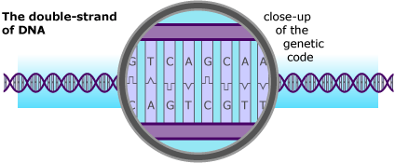
Does our DNA look like the DNA of other species?
Let's compare our DNA to our closest cousins

Slide 26
Hox Genes are similar in all animals
Hox genes in flies and people. The head-to-tail organization of the body is under the control of
different Hox genes. Flies have one set of eight hox genes, each represented as a little box in
The diagram. Humans have four sets of these gens. In flies and people, the activity of a gene
matches its position on the DNA: genes active in the head lie at one end, those in the tail at
another, with genes affecting the middle of the body lying in between.

Slide 27
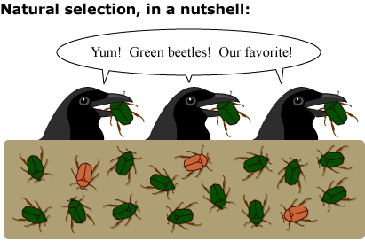
Natural Selection is a primary mechanism leading to change over time in organisms. It is the driving force behind evolution. Brain Pop!!
Psst…
Or, maybe it’s just that those
green beetles are easier
to find!!! Yummy!
Notes:
Not really green beetles are our favorite—more like, I green beetles are easy to find!

Slide 28
Some important vocabulary:
Population: A group of organisms all of the same species
Genotype: The actual set of genes (strips of DNA in the chromosomes) which an organism carries inside.
Phenotype: The outward, physical expression of those genes.
Mutation: A permanent change in the DNA of an organism. If it is passed on to the organism’s offspring, it may be harmful, harmless, or helpful for the offspring.
Notes:
Phenotypes aren’t always “outward” – blood type and protein shape are phenotypes.

Slide 29
What is Natural Selection?
Species evolve over time.
Natural Selection will occur if:
Individuals in a population (group of organisms of the same species) have genetic differences; they show variability.
Not all of the individuals reproduce, but the reproduction is not random.
The individuals with an advantageous trait will increase their chances of reproduction.
These advantageous traits are passed on to their offspring.

Slide 30
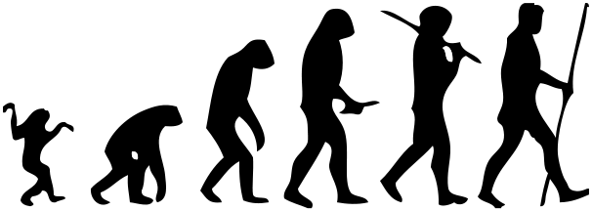
Misconceptions about Natural Selection

Slide 31
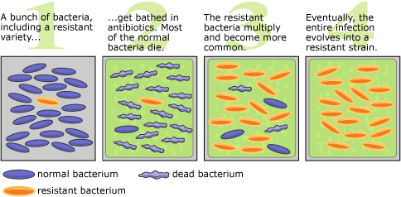
How does natural selection play a role in our own lives? Ex: Antibiotic resistance

Slide 32
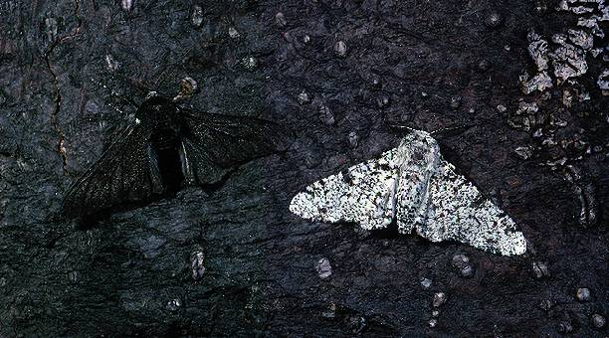
Gizmo Online Resources

